Slide 1
AI Trained Security system for better security on private property
Name of the Candidate: Ashish K Jacob , Heba Yusuf, Rakshitha Megha S
SRN:R20EL007,R20EL022, R20EL037
School: School of Electrical and Electronics
REVA UNIVERSITY
Guide: Prof. Seema Magadum

Slide 2
AI Trained Security system for better security on private property
EECE

Slide 3
Contents
Abstract
Introduction
Literature Survey
Objectives
Block Diagram
Progress Achieved
References

Slide 4
ABSTRACT
Our project uses OpenCV
OpenCV is a library of programming functions mainly aimed at real-time computer vision. Originally developed by Intel, it was later supported by Willow Garage then Itseez. The library is cross-platform and free for use under the open-source Apache 2 License.
The code is written in python.
The GUI (graphical user interface) used in this project is PyGUI to let the user decide between what to use and what not to use

Slide 5
The main Idea of the algorithm are as follows:
most of the statistics recorded is idle facts in which no pastime takes place. It uses action reputation to clear out the idle movement records and trims the component where pastime has been recorded the usage of movement detection and diverse movements.
Run the given data through the image processor and use that to work on the project.
Once the data is available it is then sent to the base system for it to be recorded and stored in a server (mostly plan on using mysql or MongoDB.)
Then once all the needed information is processed and stored in the database a web app can access the database server to present the user with the needed information in their couch

Slide 6
INTRODUCTION
Over the previous couple of years because of globalization a major exchange has been came about in exceptional sectors global including enterprise, protection, fitness, etc. one of their key sectors that are now challenge global is security and privateness. because of the emergence of shielding premises, offering security is one of the most important obligations
My project aims to make a contribution to this era of security
It aims to make securing a house a automatic task. The more the security system is used the more it autonomous it becomes making it the perfect candidate to be used in big houses with old people in it.

Slide 7
Literature survey
Author name | Date of publishing | Abstract
Rishabh Paunikar Shubham Thakare Utkarsh Anuse Prof. B.W. Balkhande | May 2020 | Most of the Data recorded is idle data where no activity takes place. It uses Action Recognition to filter the idle movement data and trims the part where activity has been recorded using movement detection and various actions. This project could be implemented at public places and could enable respective concerned departments to investigate the data at an amazingly rapid rate. Thus, in an era of increasing crimes rates, this project could be a breakthrough in untangling the evidence data and eventually assist in increasing the rate of crime resolution.
Ishan Kokadwar Anurag Kulkarni Sayali Khare Vaibhav Limbhore Prof.Swati Chandurkar | June 2020 | Over the last few years due to globalization a major change has been occurred in different sectors worldwide such as business, security, health, etc. One of their key sectors which are now concern worldwide is security and privacy. Due to the emergence of protecting premises, providing security is one of the most important tasks. Thus, to provide security, the video surveillance system was introduced. The application of video surveillance is now not only limited to provide security for area but expanded to the various sectors.
D Sai Pranav Tushar Dubey Jahanvi Singh | November 2020 | This paper will describe the significance of artificial intelligence and it’s adverse circumstances too and also the applications of artificial intelligence. It also examines the ongoing process of application technology which is being used in daily life in the real world. The paper not only explains the major applications of artificial intelligence but also apart from these applications it also gives you the journey and brief usage of AI in public sector. In the current world where artificial intelligence is being used there will be an increase in their quality and efficiency of their products which are useful for the public safety, products like CC cameras, face detection devices in public places which can identify the uncommon people or suspicious people.

Slide 8
OBJECTIVES
To implement automatic security system on a practical level
To show the capabilities of OpenCV2 to be used in this application
To create an user friendly app to fully access the functionality of the security systems from the comfort of our Sofas

Slide 9
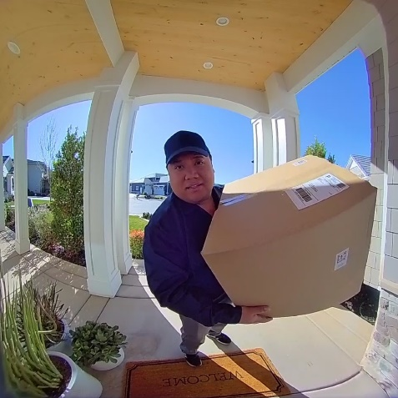
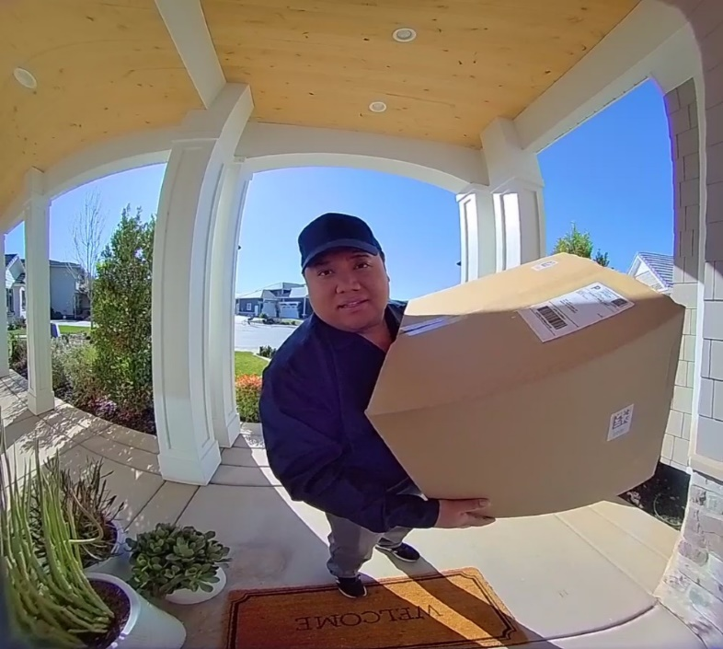

Block DIAGRAM
Desktop software
Database Storage
Security camera
Android App

Slide 10
Progress achieved
1.Courses on JavaScript to build the web application (Android app)
2.Understanding the opencv2 algorithm and learning masking
3. Decision being made on UI design of the app

Slide 11
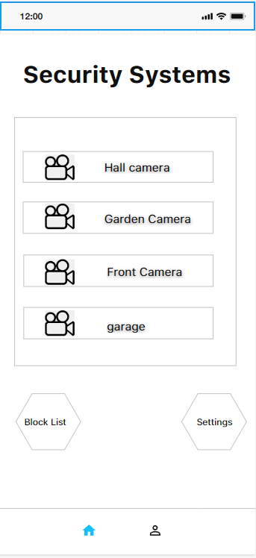
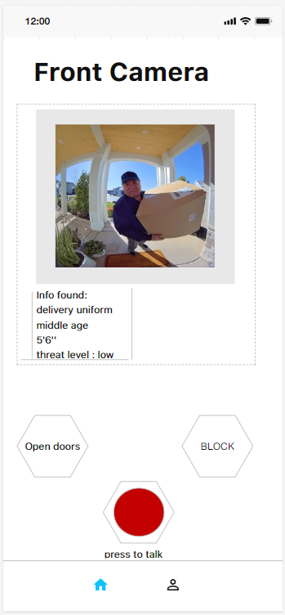
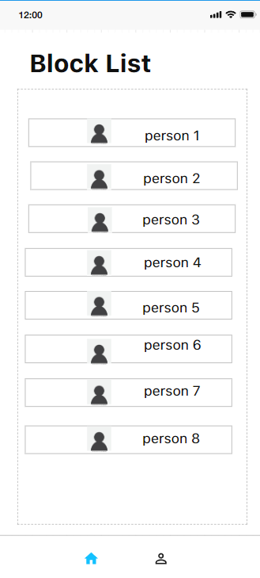
The APPlication

Slide 12
references
https://docs.opencv.org/4.x/
https://www.google.com/
https://www.researchgate.net/
https://www.irjet.net/archives/V7/i6/IRJET-V7I675.pdf
https://iopscience.iop.org/article/10.1088/1742-6596/1916/1/012034/pdf

Slide 13
THANK YOU

